Slide 1
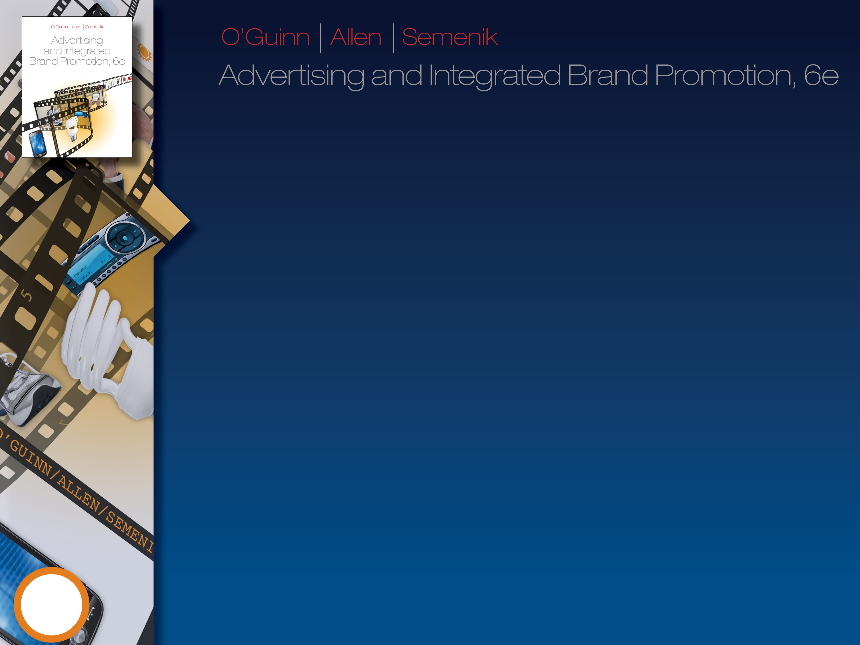

The Structure of the Advertising and Promotions Industry: Advertisers, Agencies, Media, and Support Organizations
2
©2012 Cengage Learning. All Rights Reserved. May not be scanned, copied or duplicated, or posted to a publicly accessible website, in whole or in part.

Slide 2
Constant Transition: Trends
Affecting the Advertising and
Promotion Industry
Consumer control: Social media, Blogs, DVRs
Media Proliferation, Consolidation, and
“Multiplatform” Media Organizations
Media Clutter and Fragmentation
  Greater emphasis on IBP tools
Crowdsourcing
Mobile marketing/Mobile media
2

Slide 3
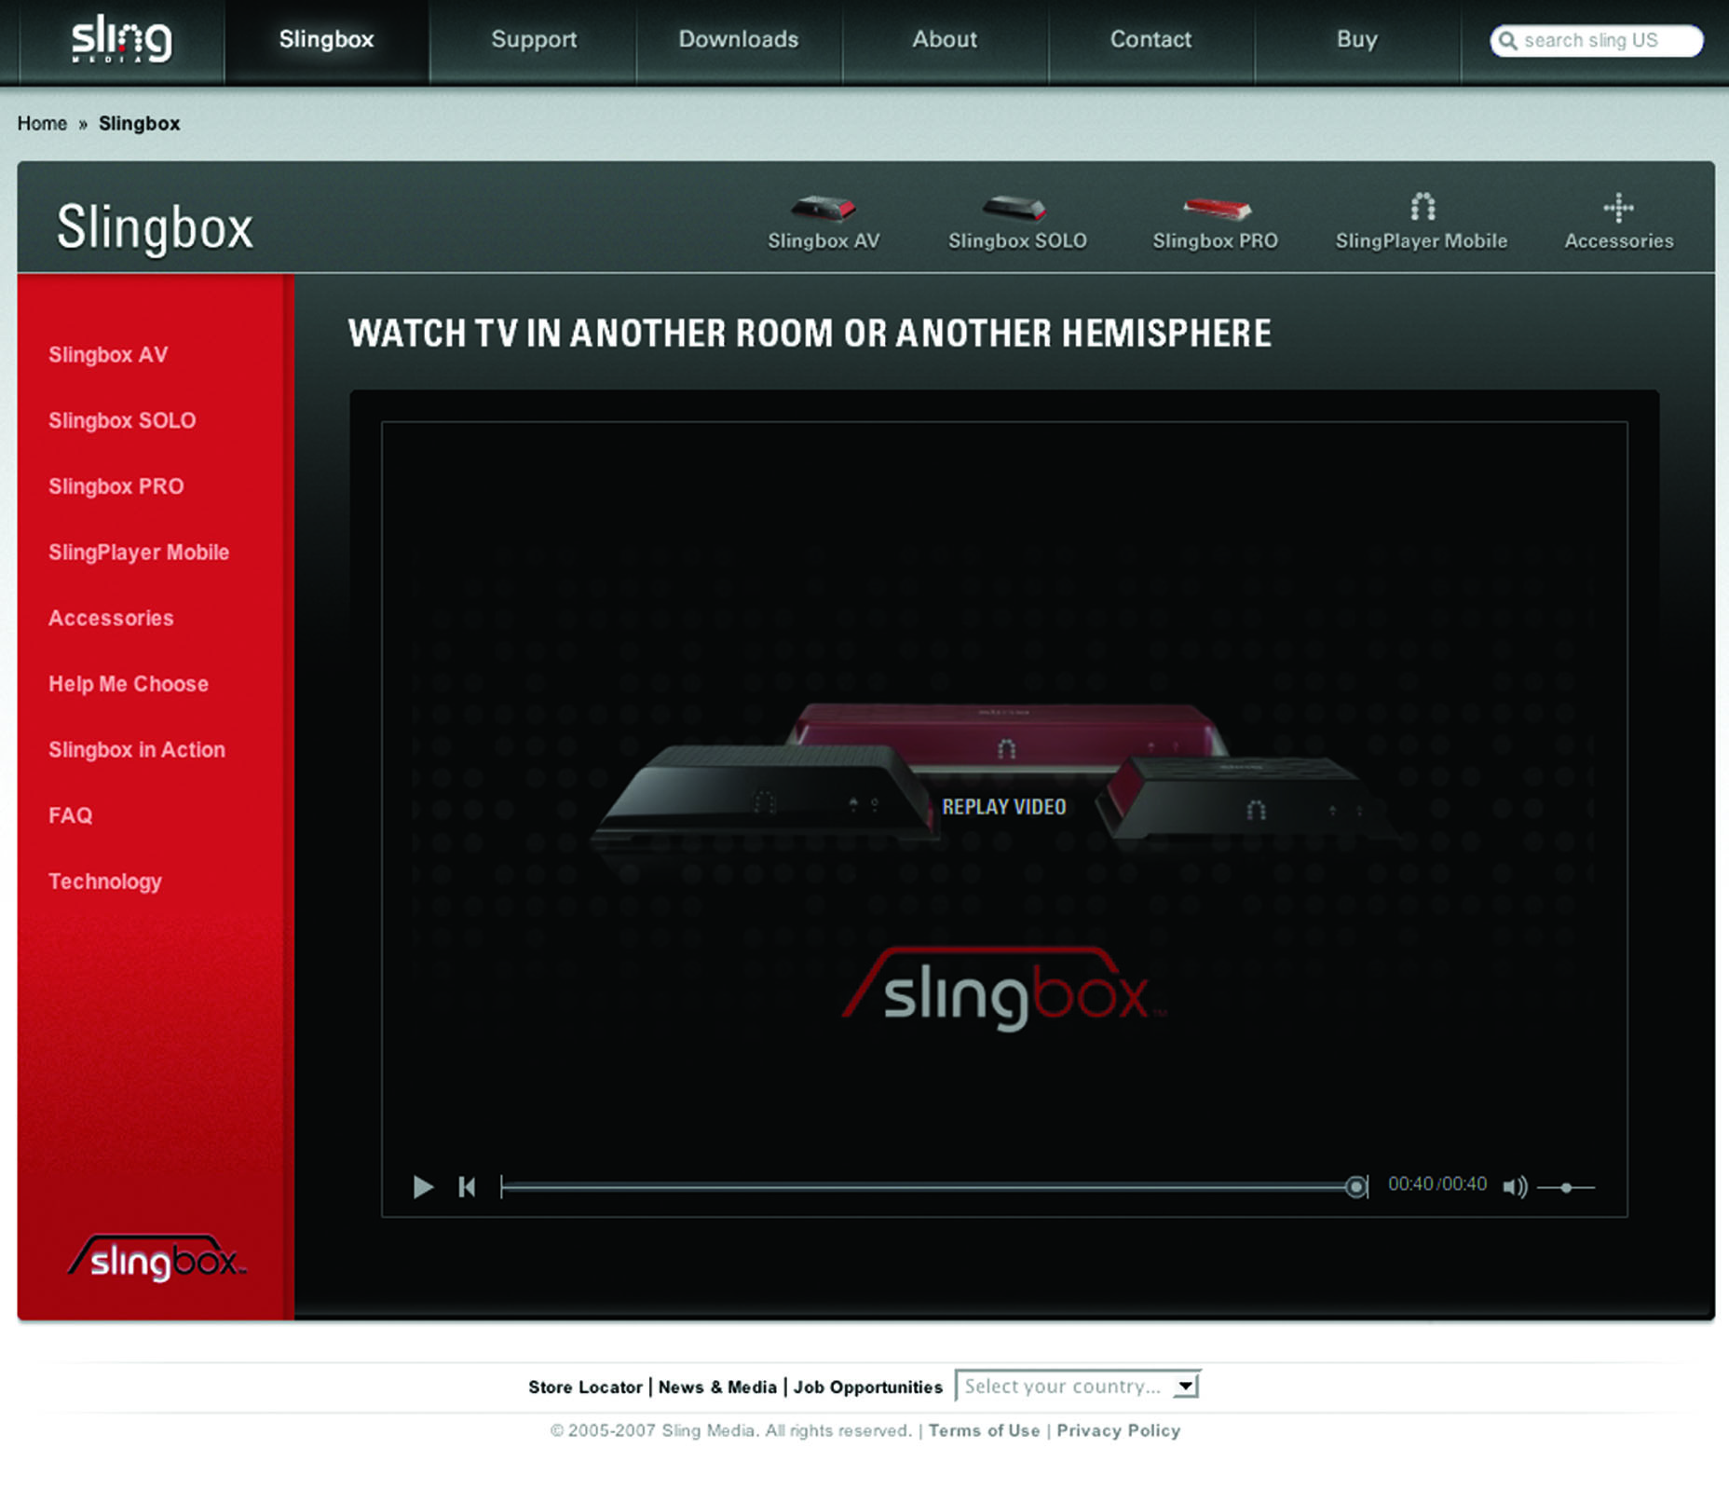
Sophisticated devices allow consumers to control their information flow
Courtesy, SlingMedia.com
2

Slide 4
Scope of the
Advertising Industry
U.S. Advertising Spending
>$300 Billion
Worldwide Advertising Spending
>$600 Billion
2

Slide 5

Structure of the Advertising and
Promotion Industry (Exhibit 2.7)
Advertisers
Advertising and
Promotion Agencies
External Facilitators
Media Organizations
Target Audiences
2

Slide 6
Advertisers
Manufacturers and Service Firms
Procter & Gamble, Verizon
Trade Resellers
Sears, McDonald’s
Government
Federal, State, Local
Social/Not-for-profit Organizations
United Way, Nature Conservancy
2

Slide 7
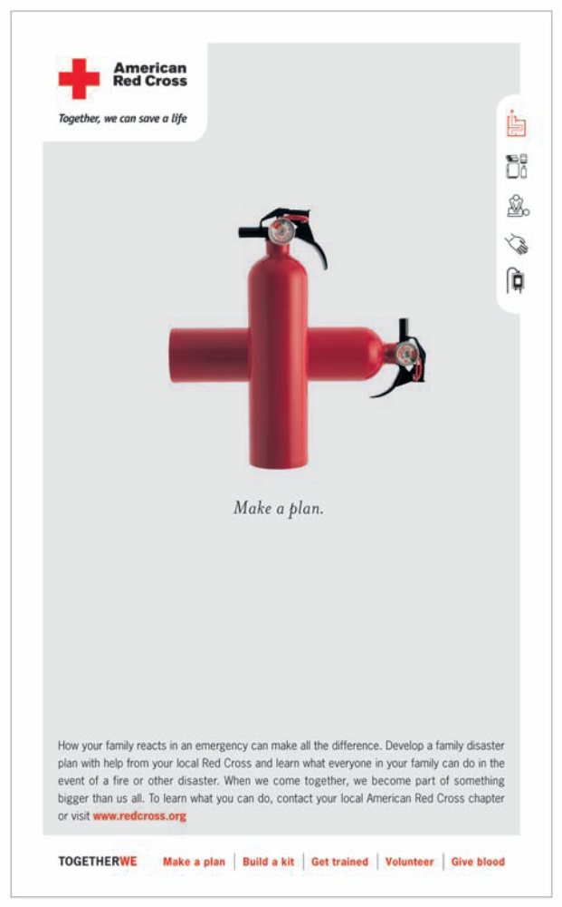
Social and not- for-profit organizations also use advertising and promotion effectively
Used with permission of The American Red Cross

Slide 8
The Role of the Advertiser in IBP:
Before the agencies get involved
Describe the value that the firm’s brand provides
Describe the brand’s position in the market
Describe the firm’s objectives for the brand
in the near-term and long-term
Identify the target market(s) that are most likely to
respond favorable to the brand
Identify and manage the supply chain/distribution
system that will most effectively reach the targets
Be committed to using advertising and other
promotional tools to grow the brand
2

Slide 9
Agencies
Advertising Agencies:
Full-Service
Creative Boutique
Digital/Interactive
In-House
Media Specialists
Promotion Agencies:
Direct Marketing/
Database
Sales Promotion
Event Planning
Design Firms
Public Relations
Firms
2

Slide 10
Some of the Agency Professionals who Help Advertisers Prepare
Advertising/IBP
Account planners
Marketing specialists
Media buyers
Art directors
Graphic designers
PR Specialists
Creative directors
Copywriters
Direct marketing
specialists
Sales Promotion
Event Planners
Web developers
Social media experts
2

Slide 11
Agencies
Advertising Agencies:
Full-Service
Creative Boutique
Digital/Interactive
In-House
Media Specialists
Promotion Agencies:
Direct Marketing/
Database
Sales Promotion
Event Planning
Design Firms
Public Relations
Firms
2

Slide 12
Full Service Agency Services
Account Services
Marketing Research Services
  Account planner
Creative and Production Services
Media Planning and Buying Services
Administrative Services
2

Slide 13
Agency Compensation
Commissions:
  Around 15% of airtime fees—in flux
  16 2/3 percent for outdoor media
  Web media is all negotiated
Markup Charges:
  Production cost + fixed %
Fee Systems:
  Hourly rates, or by project
Pay-for-Results:
  Tightly-specified objectives
  But, who is responsible for “results”
2

Slide 14
External Facilitators
Marketing and Advertising Research Firms
Consultants
  Database, Web, CRM, Traditional Management
Production Facilitators
  Facilities, technicians, in-store displays
Software Firms
  Web tracking, fulfillment
2

Slide 15
Media Organizations
Broadcast
  TV, radio, satellite
Print
  Magazines, direct mail, newspapers, specialty
Digital/Interactive Media
  Internet, interactive broadcast
  iPad, Smartphone
Support Media
  Outdoor, directories, event sponsorship, premiums,
  point-of-purchase, branded entertainment
Media Conglomerates
  Time Warner, Disney, Liberty Media
2

Slide 16
Target Audiences
Household Consumers
Businesses
Professionals
Government Organizations
2

